Slide 1
Chapter 4
Analysis Methods

Slide 2
Circuit Terminology
Node Point or portion of a circuit where 2 or more elements are joined
Essential Node Point or portion of a circuit where 3 or more elements are joined
Branch Path that connects 2 nodes
Essential Branch Path that connects 2 essential nodes w/o passing through an essential node
Loop Path with last node same as starting node that does not cross itself
Mesh Loop that does not enclose any other loops

Slide 3
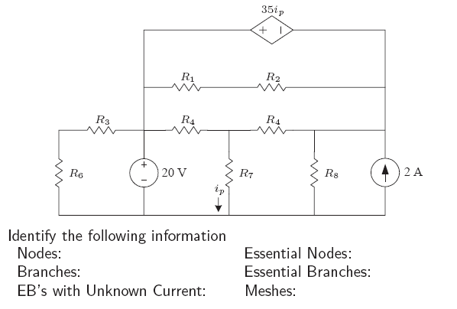
Example: Teminology

Slide 4
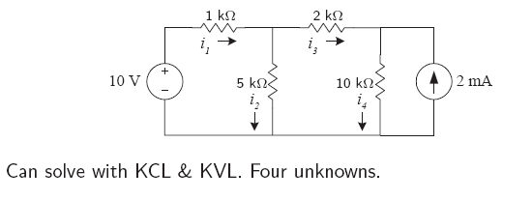
Example

Slide 5
Nodal Analysis: Introduction
There is an another way to solve for currents and voltages
– Easier
– More methodical
– Still based on Ohm’s law, KVL, & KCL
• Nodal analysis is one of two key methods
• Mesh analysis is the other
• We will discuss nodal analysis first
• Based on KCL
• Must understand terminology introduced earlier
• Use to solve for voltages
• All voltages have a common reference point

Slide 6
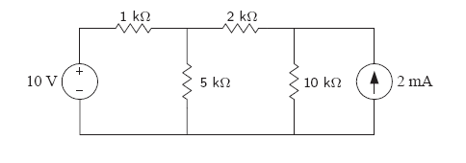
Nodal Analysis: Step 1 – Identify Essential Nodes
• Some essential nodes may include portions of the circuit (pieces of
wire)
• Circle the entire node to prevent errors

Slide 7
Nodal Analysis: Step 2 – Pick a Reference
Second step is to pick a reference node
• Is often easiest to choose the node that interconnects the most
branches
• Must be an essential node
• Usually is at bottom of circuit
• Label with the same symbol used for ground

Slide 8
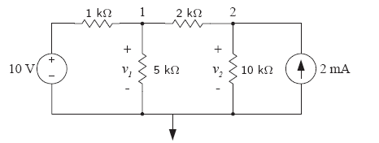
Nodal Analysis: Step 3 – Label Other Essential Nodes
Also a bit easier if voltages are labeled
• All voltages are measured relative to the reference node.
A node voltage is defined as the voltage rise from the reference node to a nonreference node.

Slide 9
Nodal Analysis: Step 4 – Apply KCL All Labeled Nodes
Generate the node-voltage equations:
Write the current leaving each branch connected to a nonreference node
Summing these currents to zero in accordance with KCL.
  The current away from node 1 through the 1K ohm resistor is (V1-10)/1K.
  The current away from node 1 through the 5K ohm resistor is (V1)/5K.
  The current away from node 1 through the 2K ohm resistor is (V1-V2)/2K.
  The sum of 3 currents leaving node 1 must equal zero.

Slide 10
Nodal Analysis: Step 5 – Solve Linear Equations
Linear Equations:
For node 1:(V1-10)/1K+ (V1)/5K+ (V1-V2)/2K=0
For node 2: (V2)/10K +(V2-V1)/2K-2m=0
V1=
V2=

Slide 11
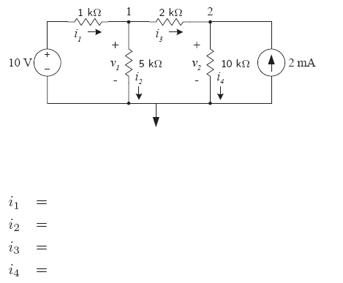
Nodal Analysis: Step 6 – Solve for Variables of Interest

Slide 12
Nodal Analysis: Review of Steps
• Step 1: Identify essential nodes
• Step 2: Pick a reference
– Must be an essential node
– Always label with the ground symbol
– Best to pick essential node with most branches
– Often at the bottom of the circuit diagram
• Step 3: Label other essential nodes
• Step 4: Apply KCL to all labelled nodes except reference node
• Step 5: Solve linear equations
– Generates voltage at each node (relative to reference node)
• Step 6: Solve for variables of interest
– Usually easy after Step 5

Slide 13
Nodal Analysis: Use of Laws
• All three laws are used
• KCL is applied at each labelled node except the reference node
• Ohm’s law is used to determine the current in branches that
contain resistors
• KVL is used to determine the voltage drop across the resistors

Slide 14
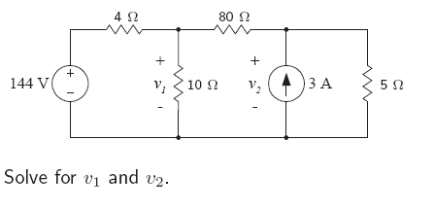
Example : Nodal Analysis

Slide 15
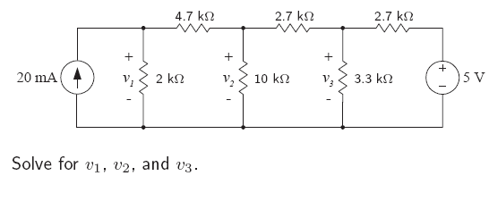
Example : Nodal Analysis

Slide 16
Node-Voltage Method : Some Special Cases
When a voltage source is the only element between two essential nodes, the node-voltage method requires some additional manipulations.

Slide 17
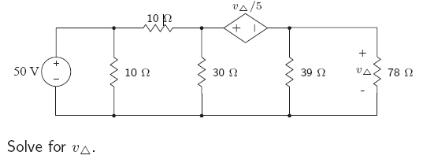
Example : Dependent Voltage Source
• What is the current flowing through the dependent source?
• How can we apply KCL at the essential nodes without this
information?
• Ans: One extra variable
• Implies we need an extra equation

Slide 18
Nodal Analysis and Supernodes
• Supernodes eliminate the need to introduce an extra variable
(unknown current)
• Necessary when a voltage source is between two labeled nodes
(excluding reference node)
• Still need to use voltage source to generate one of the equations.
SEE YOUR NOTES!!!!

Slide 19
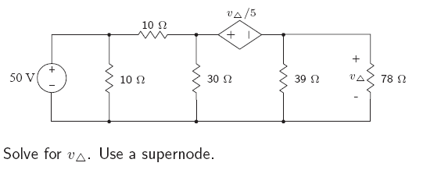
Example : Dependent Source Continued

Slide 20
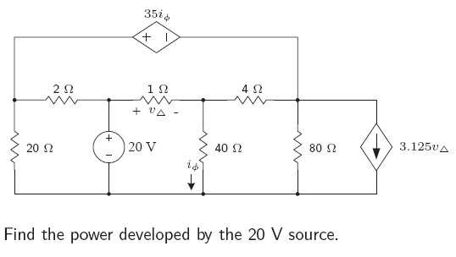
Example : Nodal Analysis

Slide 21
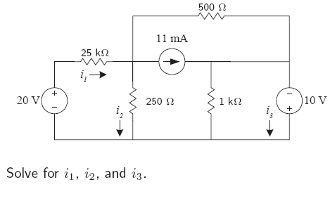
Example : Nodal Analysis

Slide 22
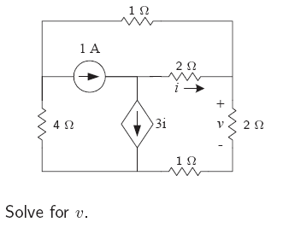
Example : Nodal Analysis

Slide 23
Mesh Analysis: Introduction
• Recall: There is an easier way to solve for currents and voltages
than applying KVL and KCL directly
• Nodal analysis is one of two key methods
• Mesh analysis is the other
Applies KVL to solve for currents
Enables us to describe a circuit in terms of be-(ne-1) equations.
Work with imaginary currents (mesh currents).
A mesh current is the current that exists only in the perimeter of a mesh.

Slide 24
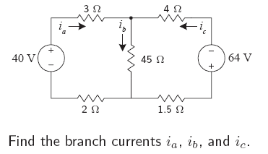
Mesh Analysis: Step 1 – Label Meshes
Recall: A mesh is a loop that does not enclose any other loops.

Slide 25
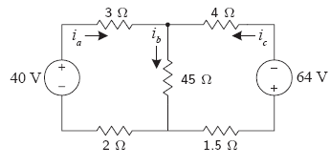
Mesh Analysis: Step 2 – Apply KVL to Each Mesh
-40+3i1+45(i1-i2)+2i1=0
45(i2-i1)+4i2-64+1.5i2=0

Slide 26
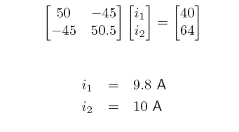
Mesh Analysis: Step 3 – Solve Linear Equations

Slide 27
Mesh Analysis: Step 4 – Solve for Variables of Interest
İa=i1
İc=-i2
İb=i1-i2

